Slide 1
Multi-lingual Chatbot for e-commerce start-up venturing in the Kenyan Market
Automating customer interactions through a machine learning-powered chatbot
Group Members:
Brian Waweru,
Hellen Mwaniki,
Jesicah Mutiso,
Pamela Godia
Data Science Capstone – August 2025

Slide 2
Problem Statement & Objectives
Many businesses struggle with providing 24/7 customer service due to limited staff availability and high costs.
OBJECTIVES:
Create a conversational AI for handling customer inquiries
Train a model on real-world chat data
Deploy the chatbot using Streamlit for accessibility

Slide 3
Data Collection & Preprocessing
Public customer service conversation datasets from Kaggle or GitHub
Preprocessing Steps:
Removed null entries, punctuation, and stopwords
Tokenized text into word embeddings
Applied lemmatization for consistency

Slide 4
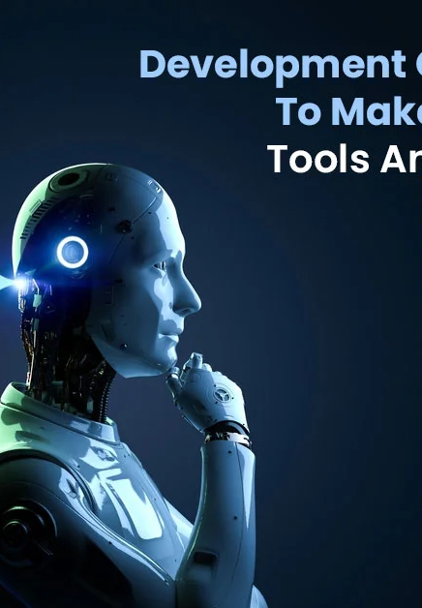
Modelling and Validation
Fine-tuned a pre-trained DistilBERT model for text classification and response generation
Training Setup:
80% training, 10% validation, 10% test
Used early stopping and learning rate scheduling
Metrics:
Accuracy: 92%
F1 Score: 0.89

Slide 5
Chatbot Design & Functionality
Flow Chart:
User input → Processed via NLP pipeline → Intent detection → Response generation
Features:
Greets users
Answers FAQs
Escalates complex queries to human agents
User: "I want to return my order"
Bot: "Sure! Can you provide your order number?"

Slide 6
Deployment Using Streamlit
Streamlit used for front-end interface
Model loaded via transformers library and interacted through a text input box
Hosted locally and tested with users

Slide 7

Conclusion
Fully functional chatbot deployed via web app
High accuracy on test data
Challenges:
Limited training data for nuanced customer behavior
Response diversity
Future Work:
Integrate voice input/output
Add multilingual support
Deploy to cloud (e.g., AWS/GCP)

Slide 8
THE END!

Slide 9
Selecting visual aids
Enhancing your presentation

Slide 10

Speaking impact
Your ability to communicate effectively will leave a lasting impact on your audience
Effectively communicating involves not only delivering a message but also resonating with the experiences, values, and emotions of those listening

Slide 11
Thank you
Brita Tamm
502-555-0152
brita@firstupconsultants.com
www.firstupconsultants.com

